Slide 1

JA COMPANY PROGRAM
PHASE 3: BUILD
WEEK 5

Slide 2

WEEK 5 AGENDA
PHASE 3: BUILD
ATTENDANCE & ICE BREAKER (25 MIN)
REVIEW (10 MIN)
KEY PERFORMANCE INDICATORS (20 MIN)
BUSINESS PLANNING (50 MIN)
COMPANY MEETINGS (10 MIN)
PRODUCT APPROVAL (15 MIN)
RECORD KEEPING REVIEW (10 MIN)
ENTREPRENEURIAL RESILIENCY MODULES (10 MIN)
QUESTIONS & WRAP UP (5 MIN)

Slide 3


WELCOME TO WEEK 5
Notes:
Attendance (5 min)
Review the attendance procedure with the VP HR and his/her team, as they should now be responsible for taking weekly attendance.

Slide 4

Ice Breaker
Choose an ice breaker!
Notes:
Optional - Ice breaker (15 min)
Choose an icebreaker or ask the executive team to lead their own!

Slide 5
REVIEW BUSINESS MODEL CANVAS, MISSION STATEMENT & CODE OF ETHICS

Slide 6





Review
BUSINESS MODEL CANVAS
MISSION STATEMENT
CODE OF ETHICS
Notes:
Review (10 min)
Take a few moments to review the Business Model Canvas, Mission Statement and Code of Ethics/Test of Disclosure created and discussed last week, as this will re-energize the group and help with business planning.

Slide 7
KEY PERFORMANCE INDICATORS

Slide 8


Key Performance Indicators & Critical Success Factors
Key Performance Indicators (KPIs) are metrics used to measure the success of a business.
Critical success factors are the key requirements for your business’s success.
Notes:
Key Performance Indicators (20 min)
Define what performance indicators are.
Before being able to determine what your KPI should be, it is important to ensure your organization has a defined business process, clear objectives for the business process, quantitative and/or qualitative data around results, and an approach for identifying and correcting variances to achieve goals.
The importance of using the Test of Disclosure in an effort to be ethical should be reviewed and discussed regularly. If participants answer ‘No’ to the Test of Disclosure, refer them back to the Code of Ethics for discussion.
Important first steps:
Now that you have a product/service, your company structure is already in place, and you have a business plan (Business Model Canvas), you should already have a good idea of your start-up capital needs.
The next step is ensuring you’ve landed on the correct break-even point for your business. To do that, you can refer back to the capital needs, resources, and break-even point worksheet created earlier.
It’s also critical to determine what Critical Success Factors (CSF) you expect. Define CSFs.
This can be on the production side (e.g. making X should cost $X per unit) or on the sales side (e.g. we should be able to sell X for $X per unit).
There are many possibilities, but the most important determinant should be what the key requirements are for your business’s success.

Slide 9


KPI Video
KPI Video
Notes:
Key Performance Indicators (20 min)
Optional – Watch the KPI video

Slide 10
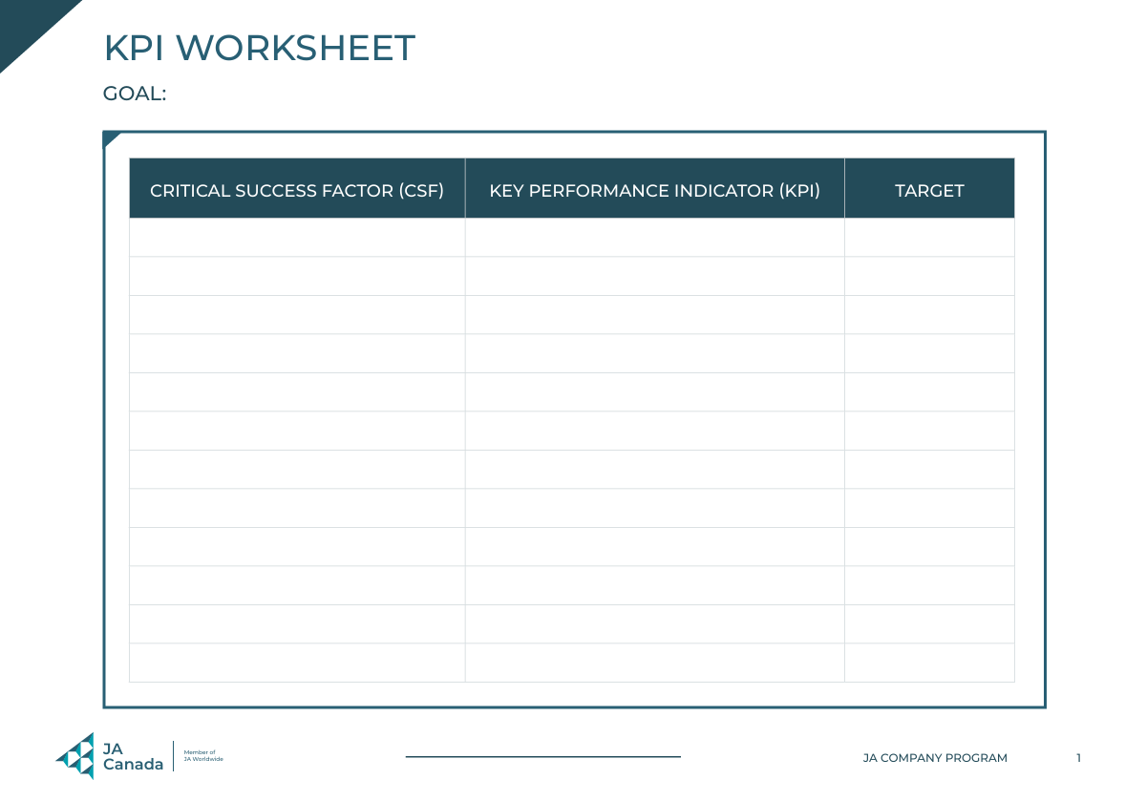
KPI Worksheet
Use the KPI Worksheet to work with your team to negotiate the details of company Critical Success Factors.
Use the Critical Success Factors to create Key Performance Indicators.
Notes:
Key Performance Indicators (20 min)
Optional – Use the KPI Worksheet
Once you’ve identified CSF and begun tracking the KPI, the process becomes one of identifying shortcomings in your business processes vis-a-vis expected results and developing methods of addressing and overcoming those shortcomings.
In the off chance that your business is meeting all its requirements for success, don’t rest just yet. You can also use KPI to improve on good-enough results to try and maximize profitability. That is the ongoing aspect of using KPI.

Slide 11
BUSINESS PLANNING

Slide 12
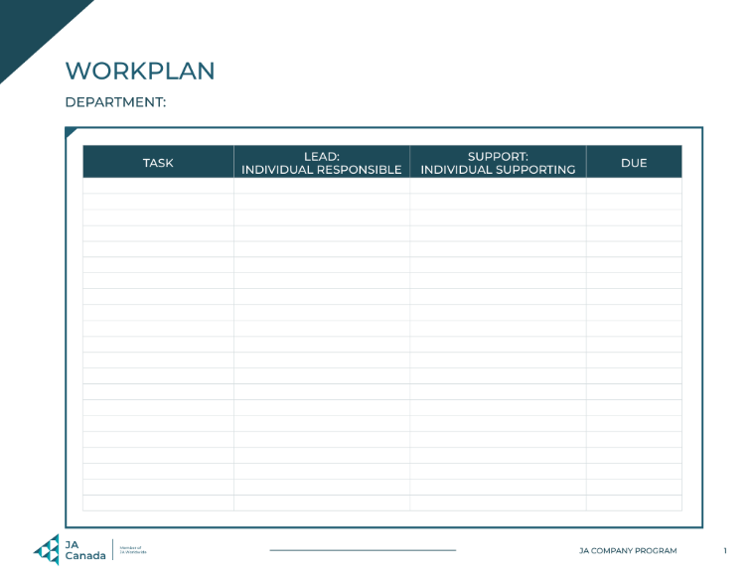
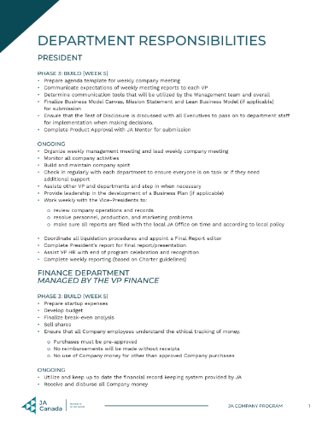
Business Planning
Review your department’s responsibilities and start to create a work plan using the Work Plan Template.
Tips for planning:
Look at your checklists
Break down tasks into small steps with measurable timelines
Think SMART
Notes:
Business Planning (50 mins)
Using the Department Responsibilities document and the optional KPI worksheet(if you are using it), break students out into their teams so they can review each department’s responsibilities and start to create a work plan using the Work Plan Template.
Encourage teams to look at their checklists and break down tasks into small steps with measurable timelines, then enter them into their Work Plan Template. Remind them of SMART goals.

Slide 13
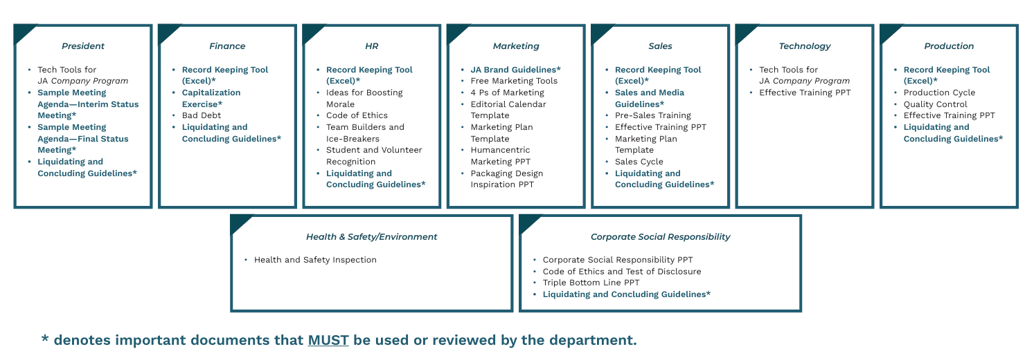
Planning Resources
Notes:
Business Planning (50 mins)
Provide each team with the Resources Available by Department document.
Allow each department to view any videos or PowerPoint presentations available to them on the JA Canada Resource Portal as part of their planning.
Remind the Leadership team to review what the Test of Disclosure is with their departments.
The VP HR should oversee the creation of the Employee Handbook, due in Week 6.
Advisor tip: Monitor each group to listen in on the planning and provide input or directions, as this is their first planning opportunity.

Slide 14

Business Planning Department Sharing
DEPARTMENTS
President
Finance
HR
Marketing
Sales
Technology
Production
Health & Safety/Environment
Corporate Social Responsibility
What are your department’s key objectives and timelines?
Do all decisions pass the Test of Disclosure?
Notes:
Business Planning (50 mins)
Bring the group back together and ask each VP to highlight key objectives for their team with timelines.
If any decisions have been made that do not seem clear, help the group use the Test of Disclosure as a guide.

Slide 15
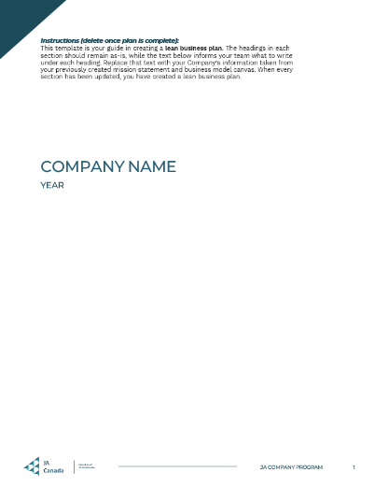
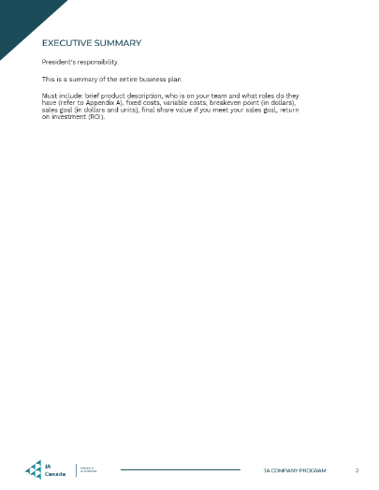
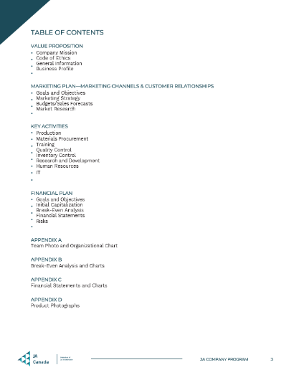
Lean Business Plan
This template is your guide in creating a lean business plan.
The headings in each section should remain as-is, while the text below informs your team what to write under each heading.
Replace that text with your Company’s information taken from your previously created mission statement and business model canvas.
When every section has been updated, you have created a lean business plan!
Notes:
Lean Business Plan (10 min, if applicable)
Review the requirements described in the Lean Business Plan template.
Begin to import information from the mission statement and Business Model Canvas into the Lean Business Plan template.
A template for the Formal Business Plan is also provided. Check with your Program Manager regarding which business planning documents you are required to use in your region (Business Model Canvas, Lean Business Plan, Formal Business Plan)

Slide 16
COMPANY MEETINGS

Slide 17

Company Meetings
When: Start of each session, beginning next week.
Purpose: To provide the Company with an overview of progress to date, discuss challenges, successes and goals, and provide an opportunity for input.
Responsibilities: The management team will lead each meeting. The President will create the meeting agenda.
Notes:
Company Meetings (10 min)
Explain that starting next week, each session will begin with a short business meeting led by the Management Team.
The purpose of this meeting is to provide the Company with an overview of progress to date, challenges, successes and goals, as well as provide an open forum for input.
The President is responsible for creating an agenda to be used for these meetings.

Slide 18
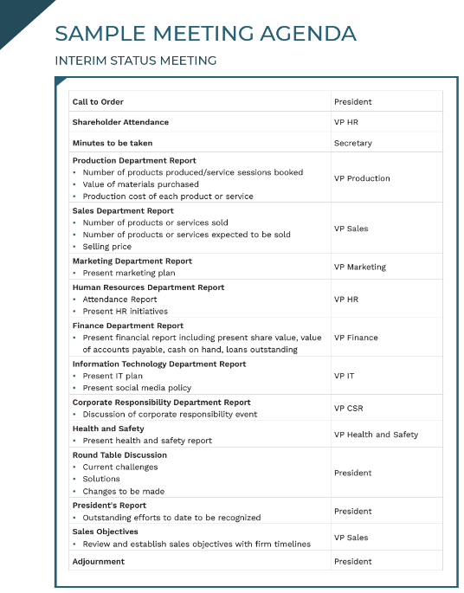
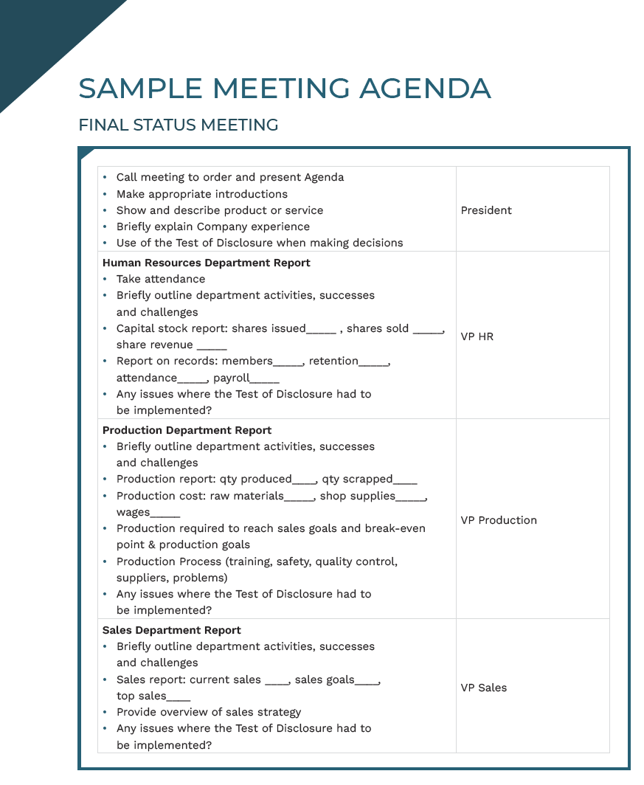
Sample Agenda
President’s report
Report from each department, including:
Goals for the session/week
Challenges, successes, and updates
Open forum for members to:
Ask questions
Identify challenges and successes
Discuss issues that may have arisen from changes that may have to be made due to the Test of Disclosure.
Upcoming items:
Deadlines, sales opportunities, etc.
Notes:
Company Meetings (10 min)
Explain that a formal Interim Status Meeting will be required in Week 8, and the Management team should review the Sample Meeting Agenda for Interim Status Meeting in advance to prepare.
They can also review the Sample Meeting Agenda for the Final Status Meeting.

Slide 19
PRODUCT OR SERVICE APPROVAL

Slide 20
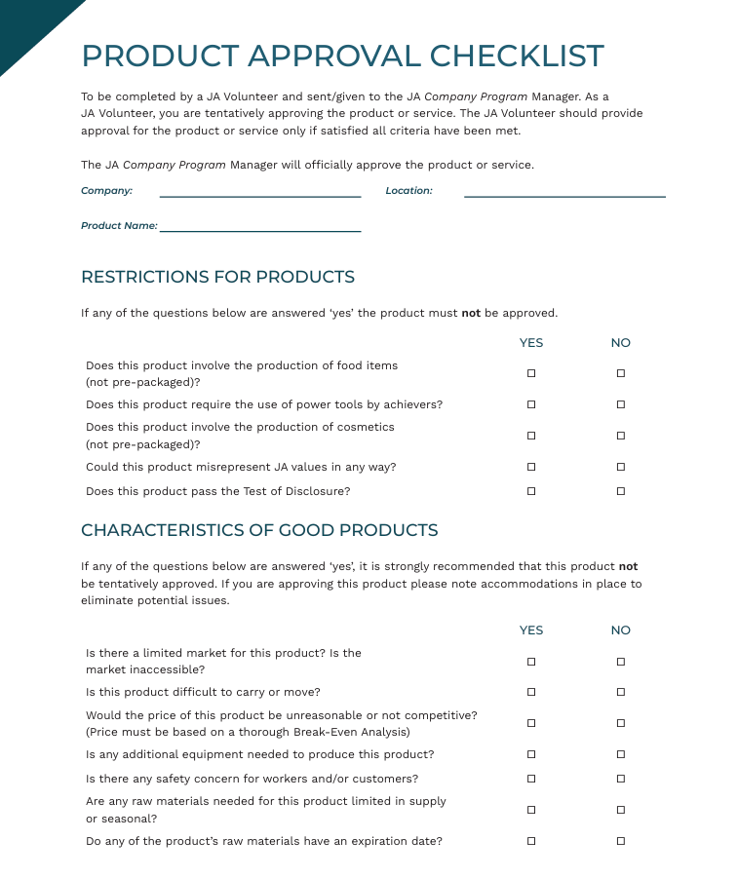

Product or Service Approval
Before production can begin, the President, VP of Production and an Advisor must complete the Product or Service Approval Checklist.
Notes:
Product or Service Approval (15 min)
Once all research and prototyping has been done for the product/service, an advisor must complete the Product or Service Approval Checklist with the President and VP Production.
This must be done BEFORE production begins and sent to the JA Program Manager.

Slide 21
RECORD KEEPING REVIEW

Slide 22

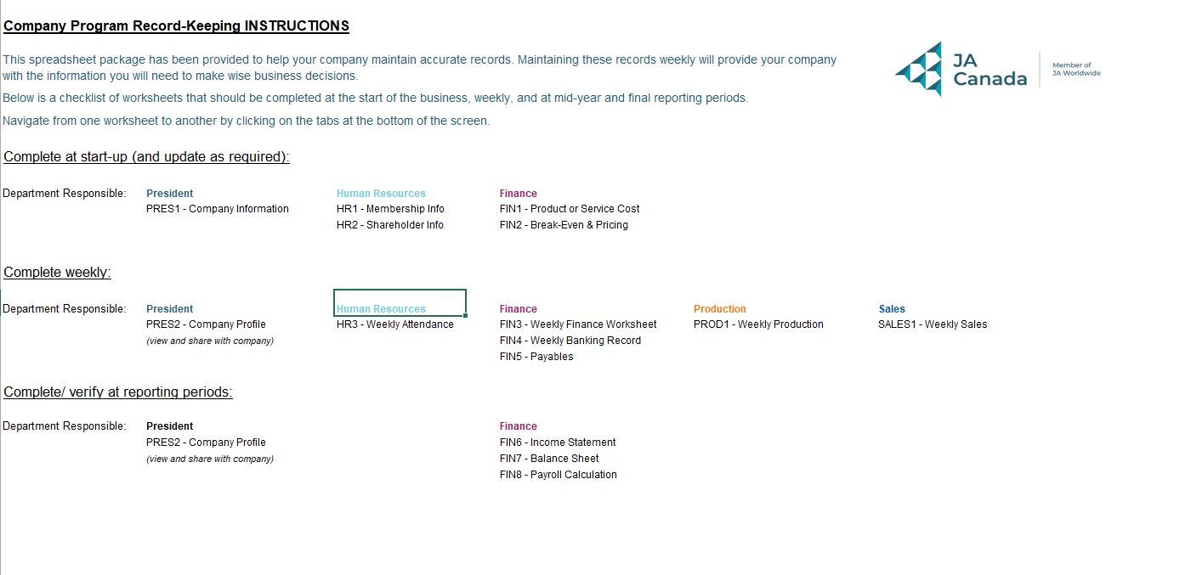
Record Keeping
Companies are responsible for keeping accurate records.
Record keeping should be:
Honest
Transparent
Accurate
Notes:
Record Keeping Review (10 min)
Each Company is responsible for accurate record keeping.
A Record Keeping Tool is available on the JA Canada Resource Portal.
The Excel document should be downloaded in a way that it can be accessed by multiple members of the team. Google Drive or other online platforms could be used.
The document MUST be shared with the JA Program Manager so they may also monitor record keeping and provide assistance as needed.
Reinforce the importance of being honest, transparent and accurate with all record keeping.
The finance, human resources, sales and production departments each have weekly inputs with regard to record keeping. Encourage students to do this immediately following the Company Meeting.
In some Charters, additional training for the Record Keeping tool may be provided.
Review on the next 3 slides the departments responsible for completing record-keeping worksheets at different points in the program.

Slide 23
Record Keeping Responsibilities
Complete at start-up (and update as required):
Department Responsible | Worksheet to Complete
President | PRES1 – Company Information
Human Resources | HR1 – Membership Info HR2 – Shareholder Info
Finance | FIN1 – Product or Service Cost FIN2 – Break-Even & Pricing
Production
Sales
Notes:
Record Keeping Review (10 min)
Review the departments responsible for completing record-keeping worksheets at start-up and updating as required.

Slide 24
Record Keeping Responsibilities
Complete weekly:
Department Responsible | Worksheet to Complete
President | PRES2 – Company Profile (view and share with company)
Human Resources | HR3 – Weekly Attendance
Finance | FIN3 – Weekly Finance Worksheet FIN4 – Weekly Banking Record FIN5 – Payables
Production | PROD1 – Weekly Production
Sales | SALES1 – Weekly Sales
Notes:
Record Keeping Review (10 min)
Review the departments responsible for completing record-keeping worksheets weekly.

Slide 25
Record Keeping Responsibilities
Complete/verify at reporting periods:
Department Responsible | Worksheet to Complete
President | PRES2 – Company Profile (view and share with company)
Human Resources
Finance | FIN6 – Income Statement FIN7 – Balance Sheet FIN8 – Payroll Calculation
Production
Sales
Notes:
Record Keeping Review (10 min)
Review the departments responsible for completing and verifying record-keeping worksheets at reporting periods.

Slide 26
ENTREPRENEURIAL RESILIENCY MODULES

Slide 27
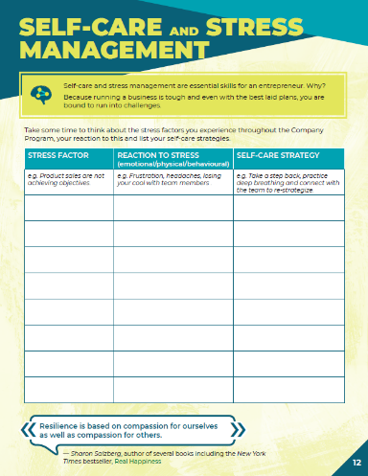
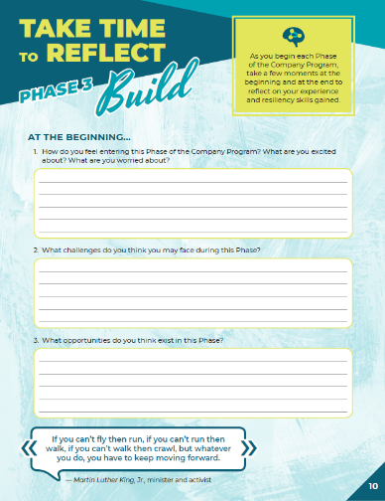

Company Program Resiliency Modules
Entrepreneurial resiliency is the ability to adapt to changes in your business and bounce back when things are challenging.
As you complete the JA Company Program, use this journal to reflect on your own resiliency and the skills you are gaining.
Notes:
Company Program Resiliency Modules (10 min)
Using the Company Program Resiliency Modules advisor guide, follow the instructions to guide students through the activities and discussions for Phase 3.

Slide 28
QUESTIONS & WRAP UP

Slide 29



Questions & Next Steps
QUESTIONS?
NEXT STEPS
Submit Product or Service Approval Checklist
Prepare to test production process next week
Notes:
Wrap-Up (5 min)
Let students know that they will have an opportunity to continue planning next week with the goal of starting production no later than Week 7.
If they are ready to begin next week, they may do so.
Review the next steps with students:
It is highly encouraged that production is ready to test their production process next week, as long as their Product/Service Approval Checklist has been submitted and approved.
Advisors:
Gather attendance records and any outstanding forms to share with the local JA Charter office.
If you were not able to cover any material, make a note and move it to your next meeting.
Address any questions, concerns or feedback to your Company Program Manager.

